Slide 1
Sustainability
Means that things can keep going
Can sustain themselves
Can continue into the future and go on forever

Slide 2
From a Human perspective
Sustainability for our Planet means that it can continue to do what it was designed to do

Slide 3
Provide Fresh air, Clean water, produce Food
And
Allow us all to have High Quality of life Forever

Slide 4
onsustainability means that
It cannot
Some say, that is where we are now

Slide 5
Scientist in Sweden developed a definition
For a sustainability with four basic principles.
These can be seen as the care instruction's for our planet, if we follow them it is good for our planet and because we are part of system that is our planet it is good for us too.

Slide 6
The care instructions are as follows
Reduce our dependence on fossil fuels and heavy metals
Reduce our dependence on synthetic chemicals that effect nature
Reduce out destruction of nature
Ensure we are not stopping people globally from meeting their needs
Demand for the Earths services Clean Air, Water, Food

Slide 7
Increases as the population increases
And living standards rise
But!
The Earths ability to provide these services is declining because of the way we are living
In our search for prosperity growth and success we are destroying the system that we as humans are completely dependant on – Nature
WE humans have become a threat to our own way of life

Slide 8
The Earth is a system and everything is connected
Society, Environment and Economy
To live sustainably we need to follow the four care
instructions and apply them to everything we do at
Home and at Work

Slide 9
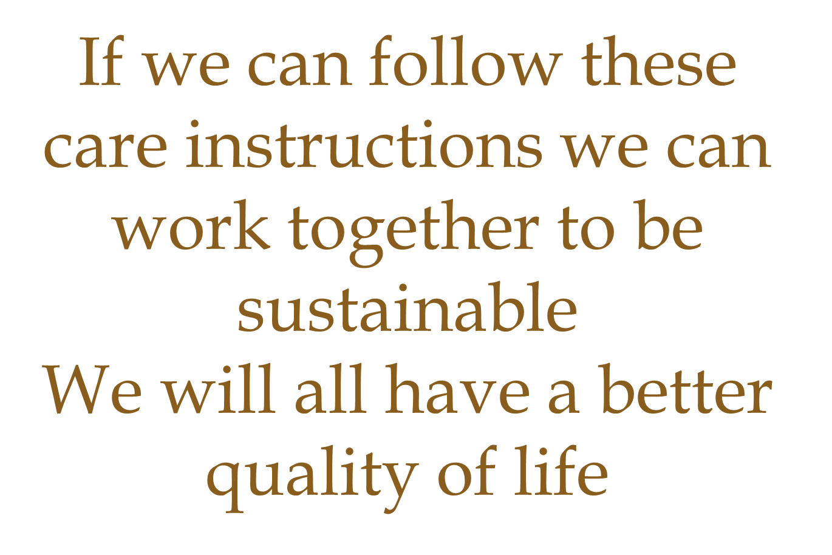
Care Instructions

Slide 10
We will
Waste less
Pollute Less
And we will create more things we value in society while improving our Planets chances of providing us with the very things we need to survive

